Slide 1
Money Management Android App For Ease In Trading
SOFTWARE DEVELOPMENT PROJECT
IC-C-24

Slide 2
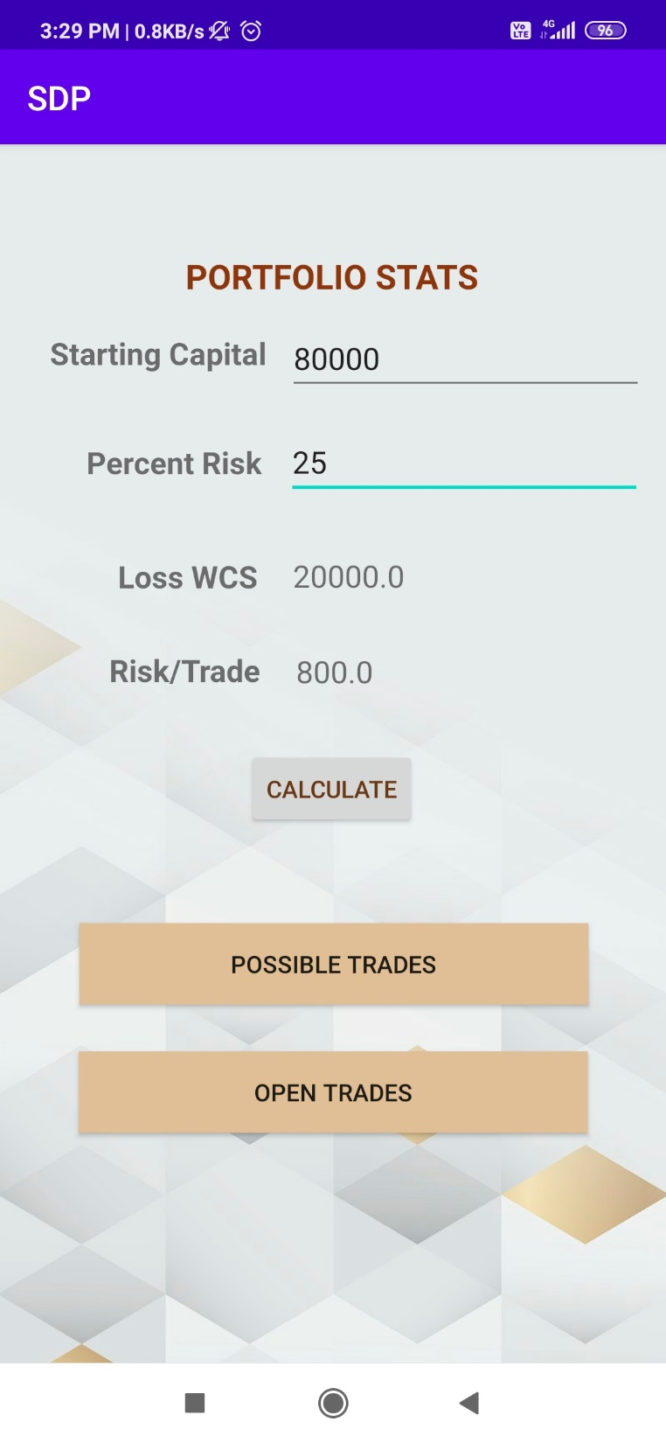
Front Page

Slide 3
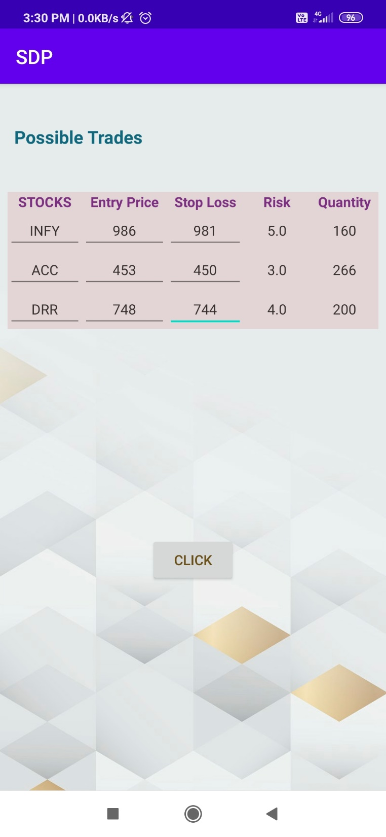
Possible Trades

Slide 4
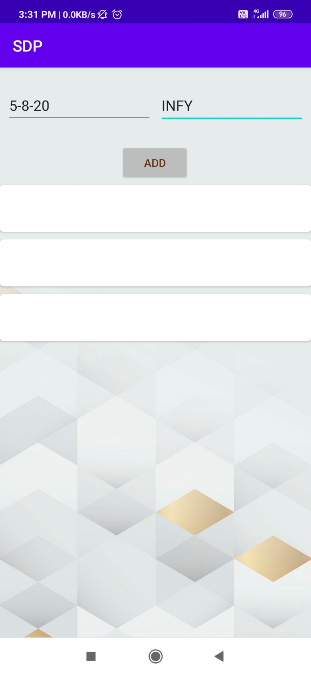
Open Trades List

Slide 5
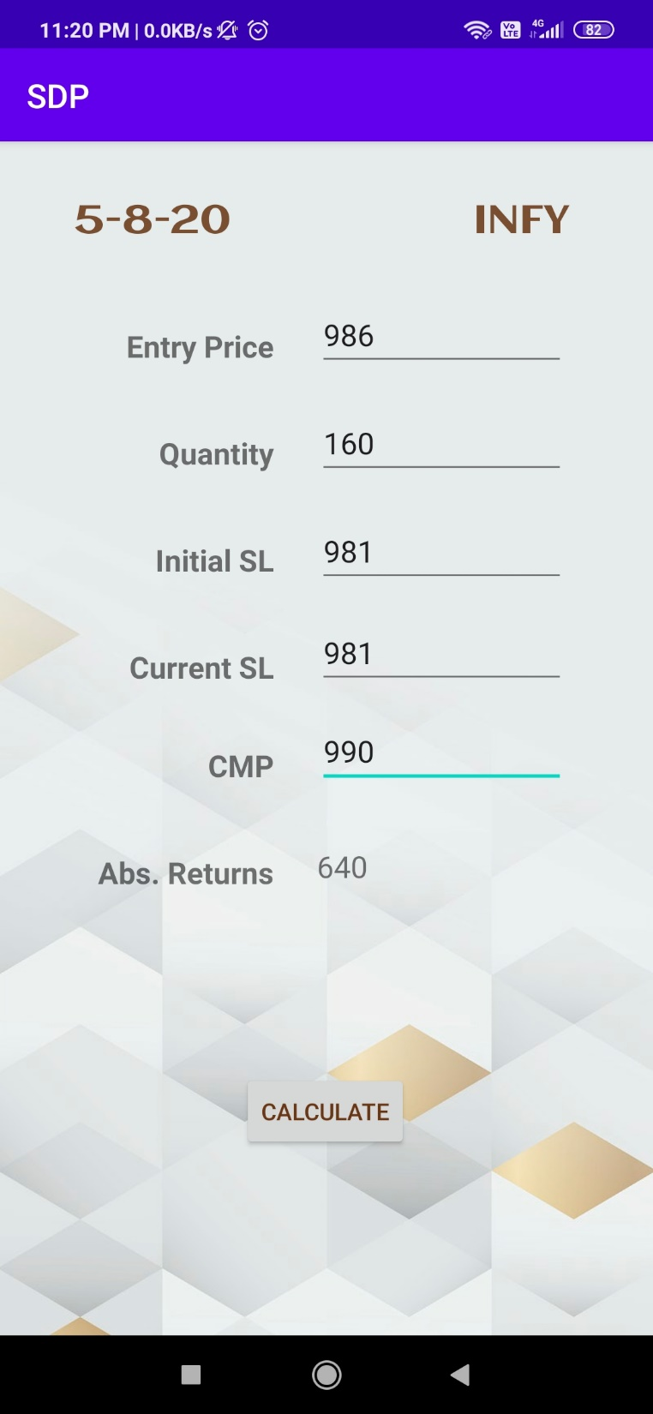
Open Trades

